Slide 1
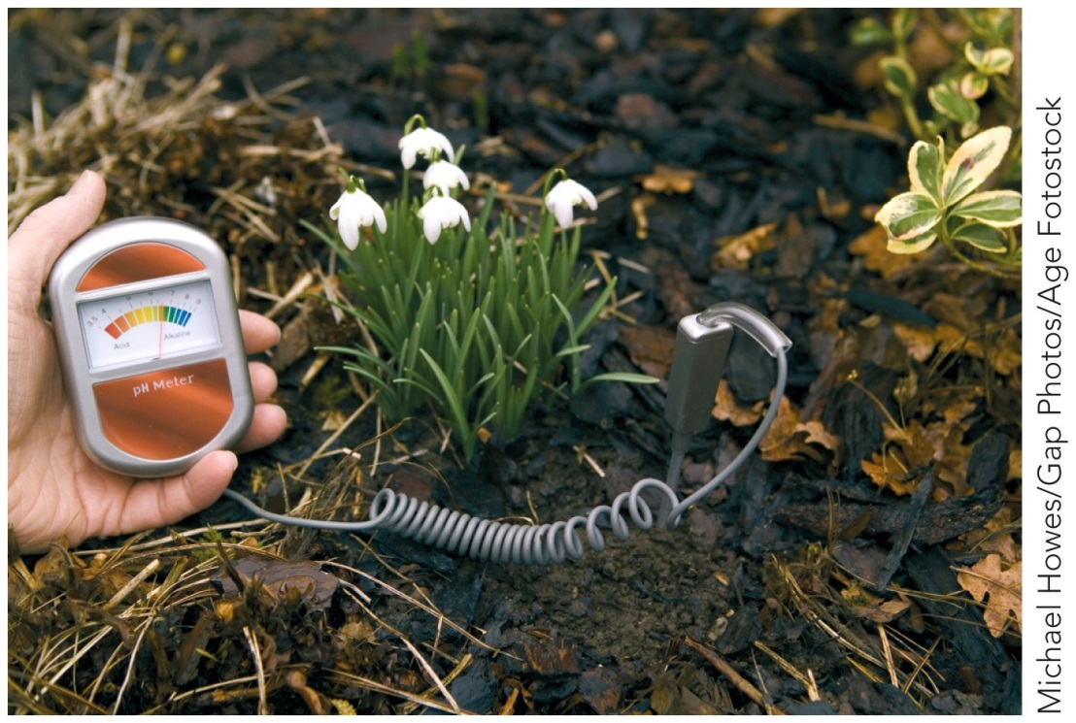
Acids, Bases, and Salts
Chapter 15
Outline
Properties
Definitions
Arrhenius
Brønsted-Lowry
Lewis
Ionization of Water
pH
Stoichiometry
Buffers
Chemical Equations
Total Ionic
Net Ionic
Acid and Base Reactions

Slide 2
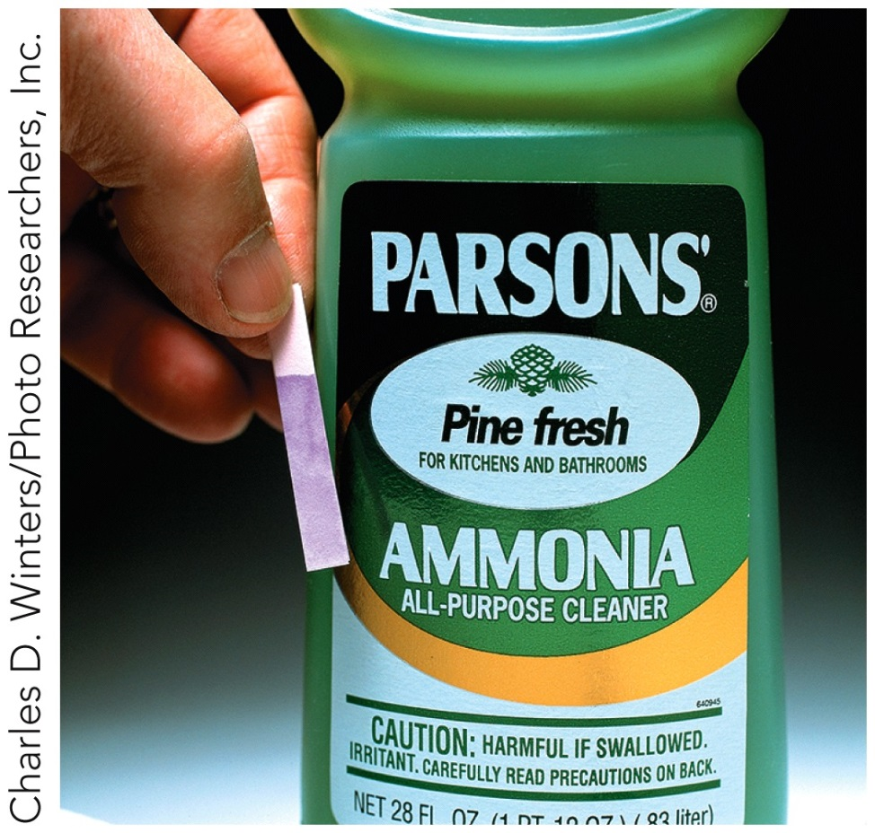
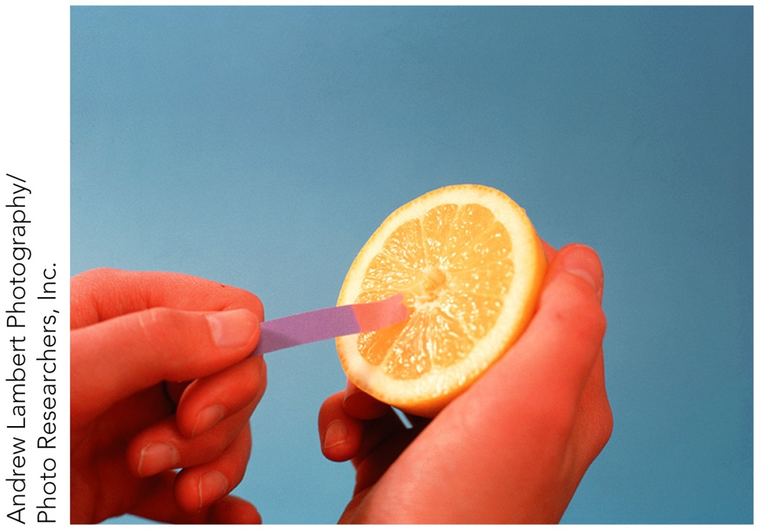
How do acids and bases react with litmus paper?

Slide 4
What are the general acid-base definitions?
 | Arrhenius | Brønsted-Lowry | Lewis
Acid | Forms H⁺ in solution | proton donor | Electron-pair acceptor
Base | Forms OH⁻ in solution | proton acceptor | Electron-pair donor

Slide 5
What do acids do in solution?
Form H⁺ or H₃O⁺ in solution.
HA $⇌$ H⁺ + A­
or
HA + H₂O $⇌$ H₃O⁺ + A­

Slide 6
What do bases do in solution?
Forms OH⁻ in solution.
BOH $⇌$ B⁺ + OH^{­-} or
B + H₂O $⇌$ BH⁺ + OH^{­-}

Slide 7
Acids

Slide 8
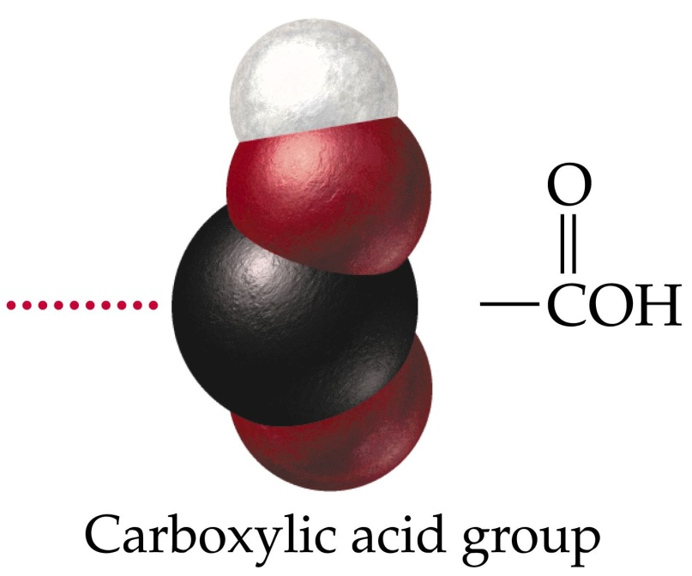
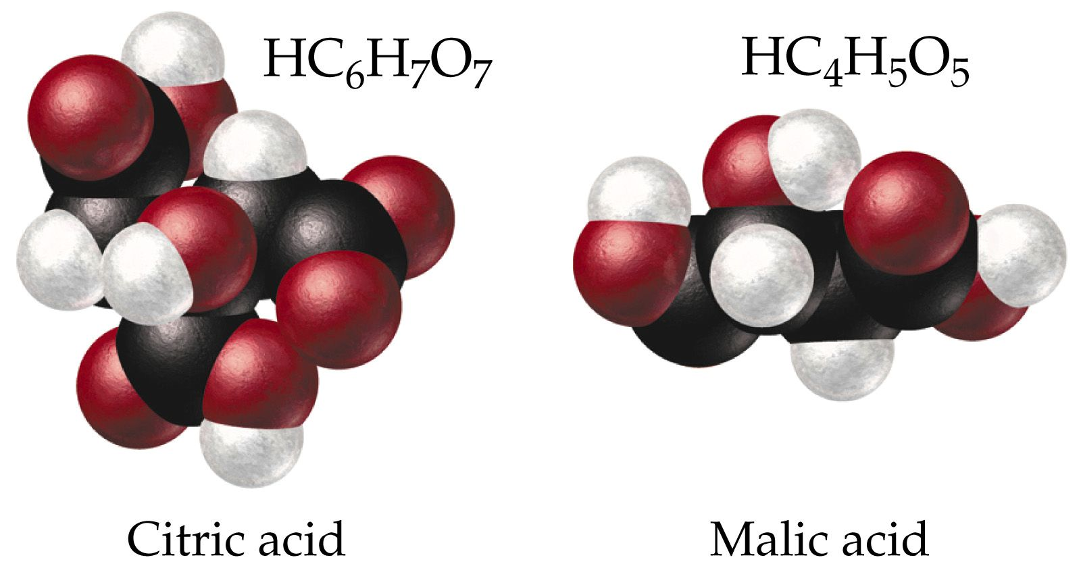
Organic acids frequently contain a carboxylic acid group

Slide 9
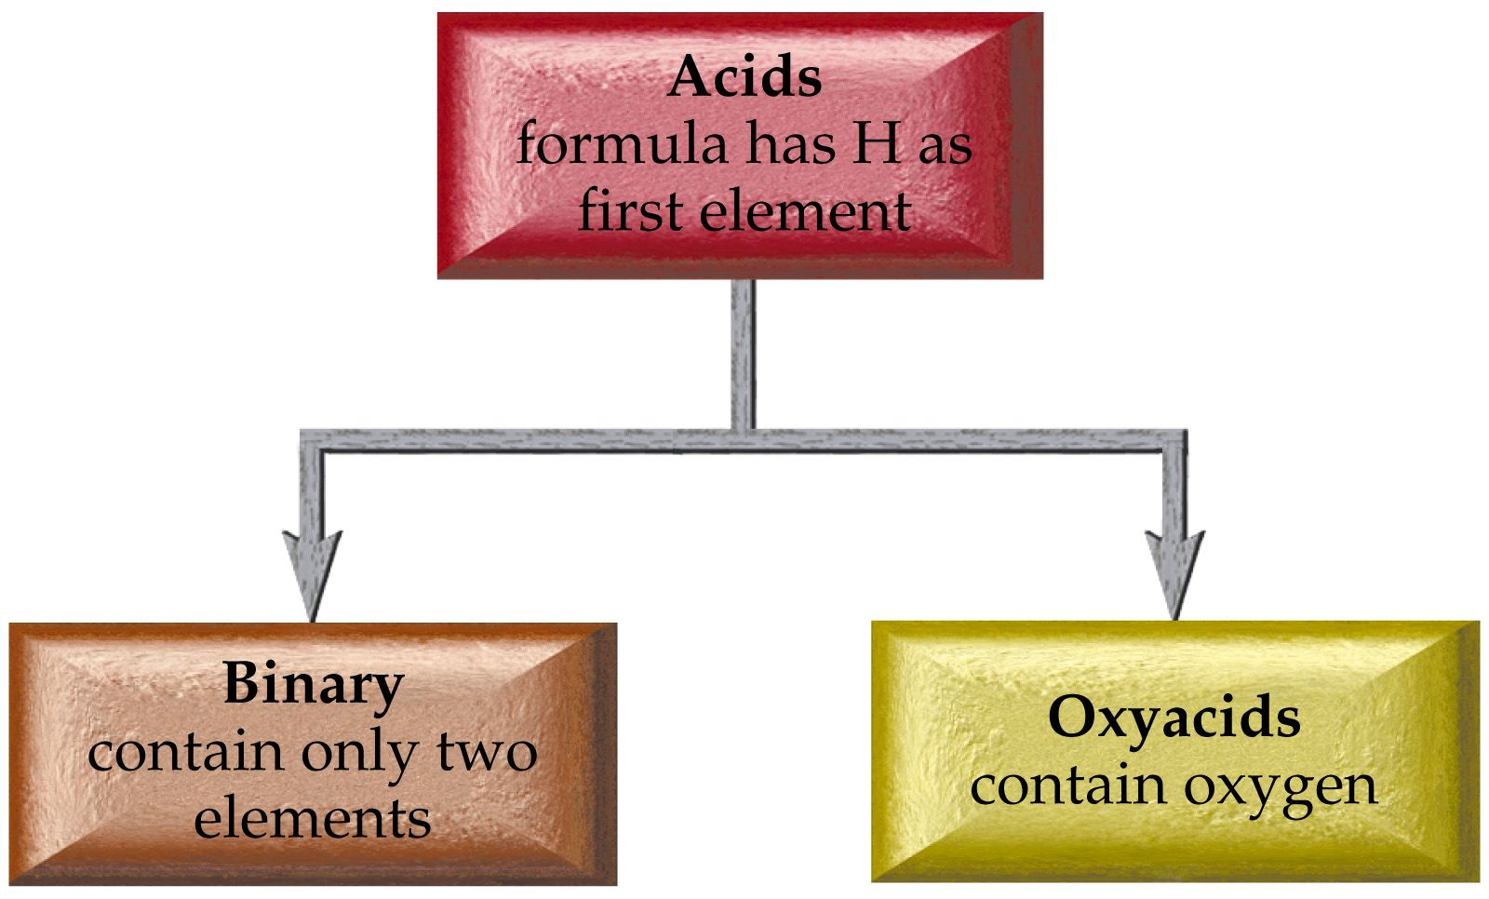

Slide 10
Acid Nomenclature
Binary Acids
HX hydrogen _____ide
becomes
Hydro______ ic acid

Slide 11
HCl(g) hydrogen chloride
HCl (aq) hydrochloric acid
H₂S(g) hydrogen sulfide
H₂S(aq) hydrosulfuric acid
HCN(g) hydrogen cyanide
HCN(aq) hydrocyanic acid

Slide 13
Oxyacid Nomenclature
Hydrogen ___ate → ___ic acid
Hydrogen ___ite → ___ous acid
Hydrogen per __ate → per__ic acid
Hydrogen hypo__ite →hypo__ous acid

Slide 14
Example – Acid Nomenclature
What is the name of HCl _{(aq)}?
Chloric acid
Hydrochloric acid
Hydrogen chloride
Hydrochlorous acid
B and C

Slide 15
Example – Acid Nomenclature
What is the name of the carboxylic acid HC₂H₃O_{2 (aq)}, which can also be written: CH₃COOH _{(aq)}?
Acetic acid
Hydroacetic acid
Acetous acid
Ethanoic acid
A and D

Slide 16
Example – Acid Nomenclature
What is the formula for phosphorous acid?
H₃PO_{3 (aq)}
H₃P _{(aq)}
H₃PO_{4 (aq)}
PO_{3 (aq)}
H₂PO_{3 (aq)}

Slide 17
Common Acids
H₂SO₄ sulfuric acid
H₂SO₃ sulfurous acid
H₂CO₃ carbonic acid
HClO hypochlorous acid
H₂TeO₃ tellurous acid
HBrO₄ perbromic acid

Slide 18
Common Strong Acids and Bases
Common Strong Bases
Lithium hydroxide LiOH _{(aq)}
Sodium hydroxide NaOH _{(aq)}
Potassium hydroxide KOH _{(aq)}
Strontium hydroxide Sr(OH)₂ _{(aq)}
Barium hydroxide Ba(OH)₂ _{(aq)}
Calcium hydroxide Ca(OH)_{2 (aq)}
Common Strong Acids
Hydrochloric acid HCl _{(aq)}
Hydrobromic acid HBr _{(aq)}
Hydroiodic acid HI _{(aq)}
Perchloric acid HClO_{4 (aq)}
Chloric acid HClO_{3 (aq)}
Nitric acid HNO_{3 (aq)}
Sulfuric acid H₂SO_{4 (aq)}

Slide 19
Acid Base Reactions
Conjugate acid base pair
HA + B $⇌$ A­ + BH⁺
acid base conjugate conjugate
base acid
Acid HA ➔ Conjugate base A­
Base B ➔ Conjugate acid BH⁺

Slide 20
How does a Brønsted-Lowry acid-base reaction work?

Slide 21
How does a Brønsted-Lowry acid-base reaction work?

Slide 22
How does a Brønsted-Lowry acid-base reaction work?

Slide 23
Why does water react with itself?

Slide 24
In pure water
H₂O _{(l)} + H₂O _{(l)} $⇌$ H₃O⁺ _{(aq)} + OH­ _{(aq)}
[H₃O⁺] = [OH⁻] = 1.0 x 10⁻⁷ M
[H₃O⁺] × [OH⁻] = 1.0 x 10⁻¹⁴ M²

Slide 25
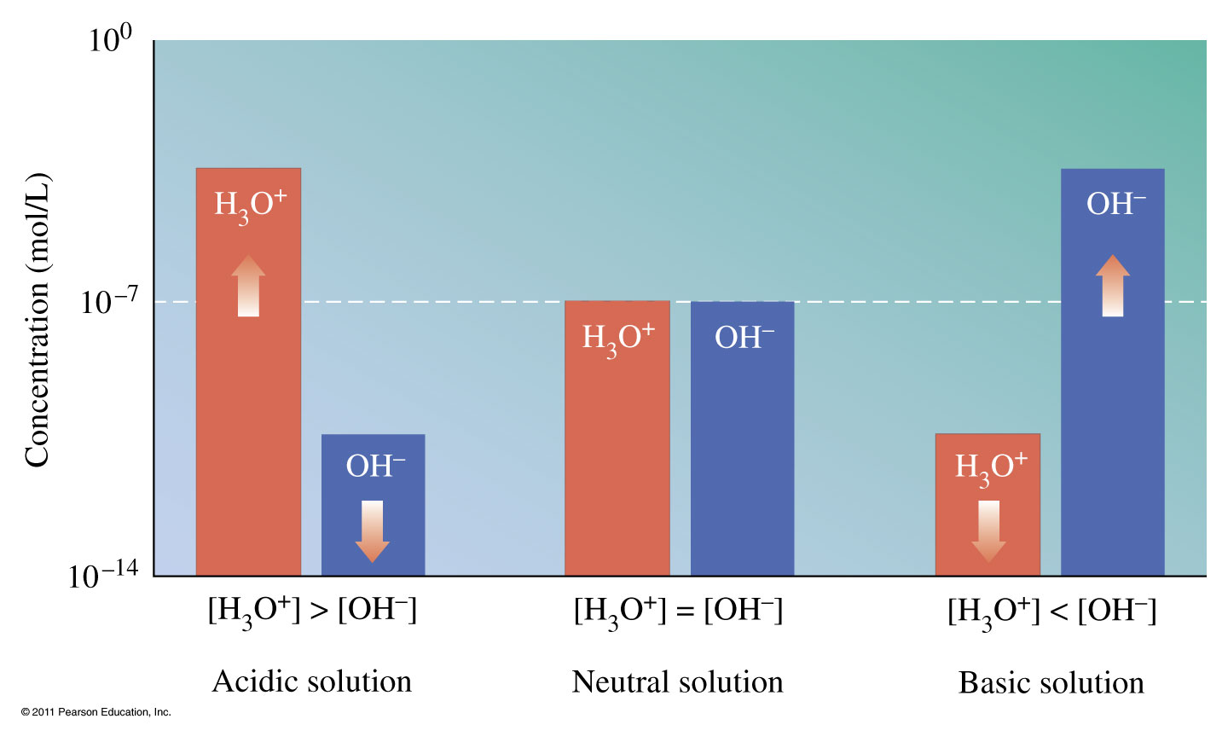
How does [H₃O⁺] and [OH⁻] differ?

Slide 26
Example - K_{w}
If the proton ion concentration of vinegar is 2.1 x 10⁻³ M at 25 °C, what is the hydroxide ion concentration?

Slide 27
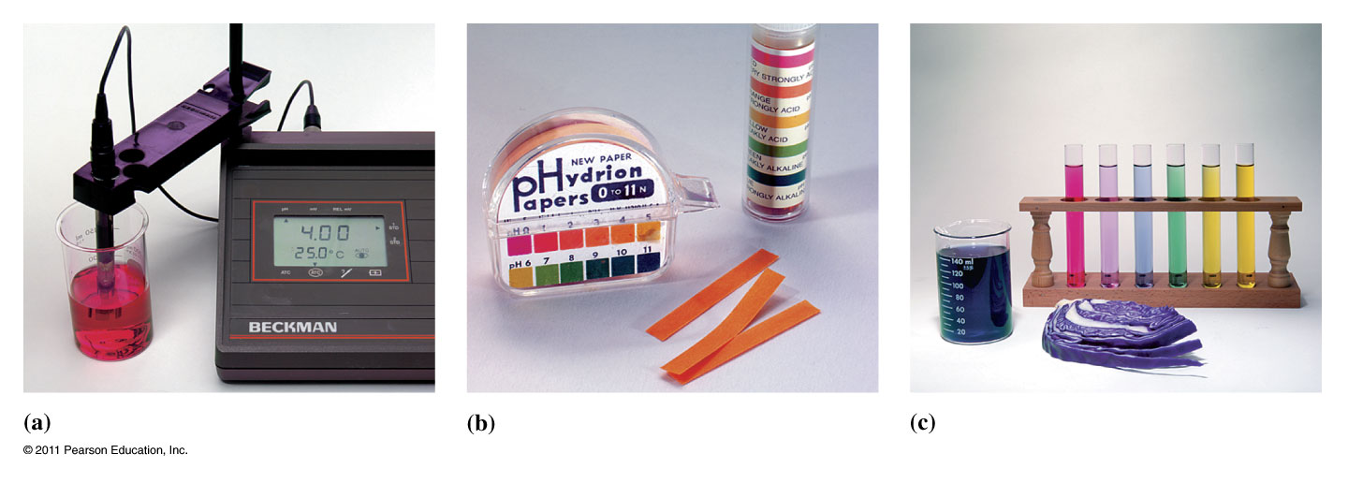
What does the pH scale tell us?
pH = 7 ➔ neutral
pH > 7 ➔ basic solution
pH < 7 ➔ acidic solution

Slide 28
pH is a method used to describe the concentration of H₃O⁺(H⁺) in a solution easily.
pH = ­log[H₃O⁺]
where [H₃O⁺] = concentration of H₃O⁺ in mol/L or molarity (M)

Slide 29
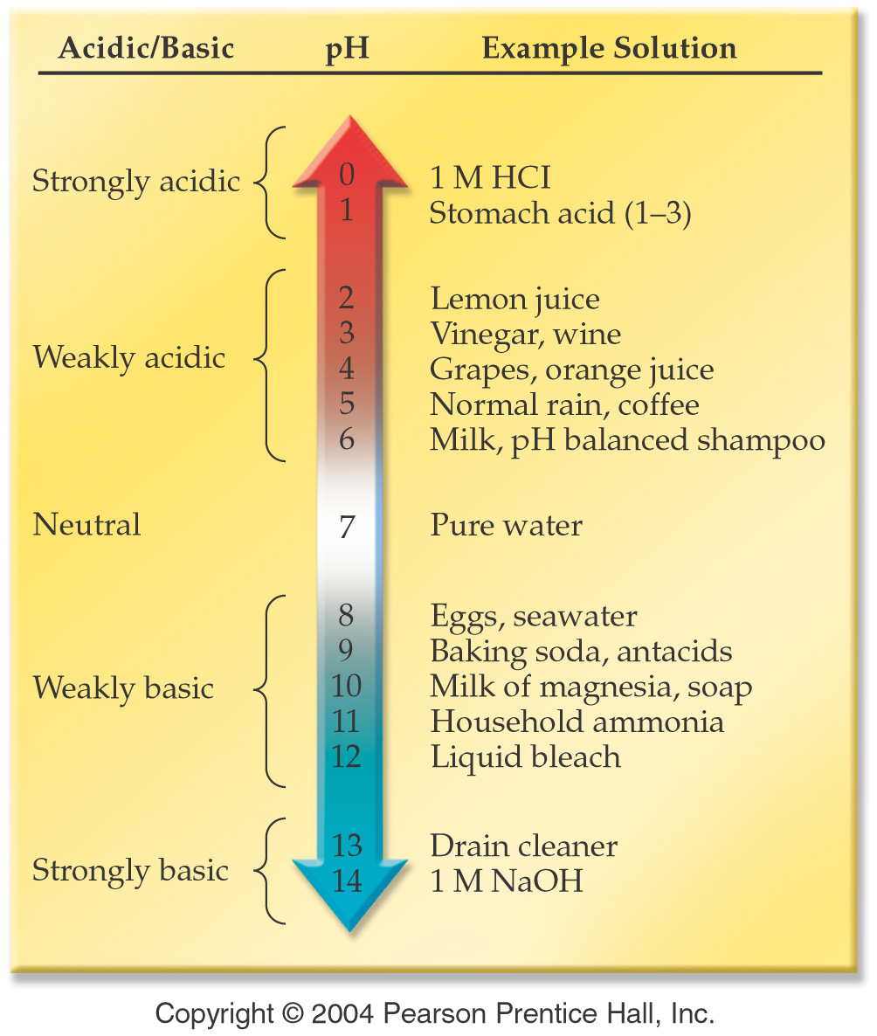

Slide 30
How is pH measured?

Slide 31
Classify each of the following foods as acidic, basic or neutral
egg white, pH = 7.9
maple syrup, pH = 7.0
champagne, pH = 3.8
sour milk, pH = 6.2
lime juice, pH = 1.8
tomato juice, pH = 4.1

Slide 32
Classify each of the following foods as acidic, basic or neutral
egg white, pH = 7.9
maple syrup, pH = 7.0
champagne, pH = 3.8
sour milk, pH = 6.2
lime juice, pH = 1.8
tomato juice, pH = 4.1
Basic
Neutral
Acidic
Acidic
Acidic
Acidic

Slide 33
Example - pH
Find the pH of coffee when the hydrogen ion concentration is 0.0010 M.

Slide 34
Example - pH
A bottle of table wine has [H₃O⁺] = 3.2 x 10⁻⁴ M. After one month the [H₃O⁺] rises to 1.0 x 10⁻³ M. Calculate the pH of the new and old bottle of wine and explain the changes observed.

Slide 35
Example – pH and pOH
[H₃O⁺] | [OH⁻] | pH | pOH
5.98 x 10⁻¹¹ M
 | 9.63 x 10⁻⁵ M
 |  | 9.092
 |  |  | 10.05

Slide 37
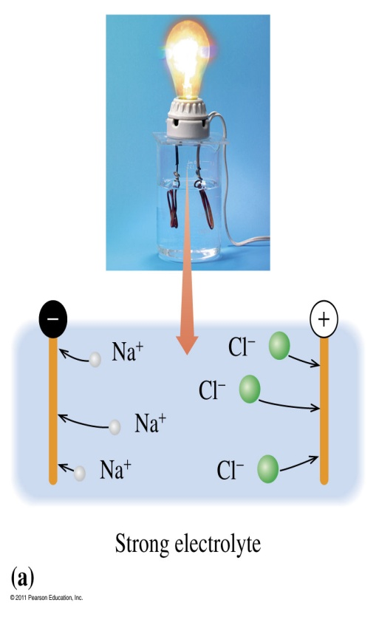
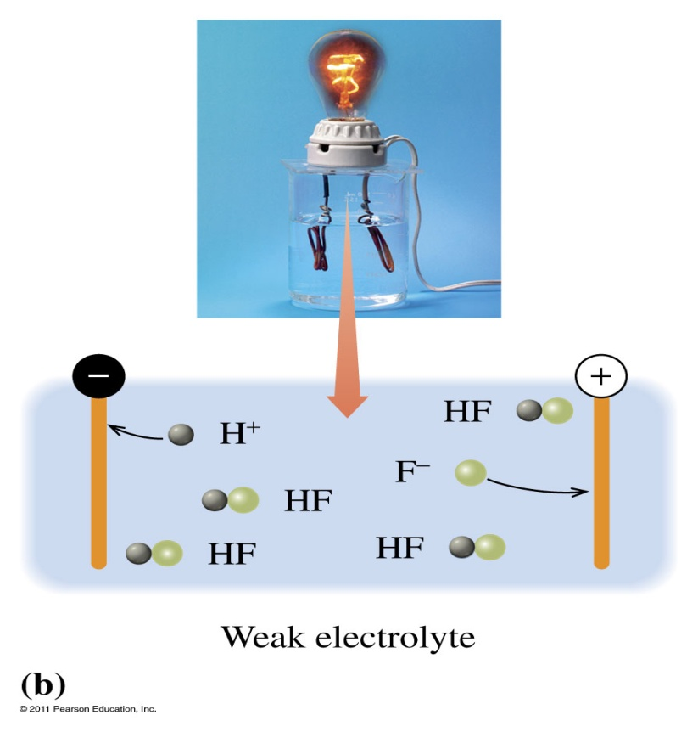
Are ionic compounds conductive?
A strong electrolyte in an aqueous solution completely dissociates into ions.
The weak electrolyte in an aqueous solution forms mostly molecules and a few ions.

Slide 38
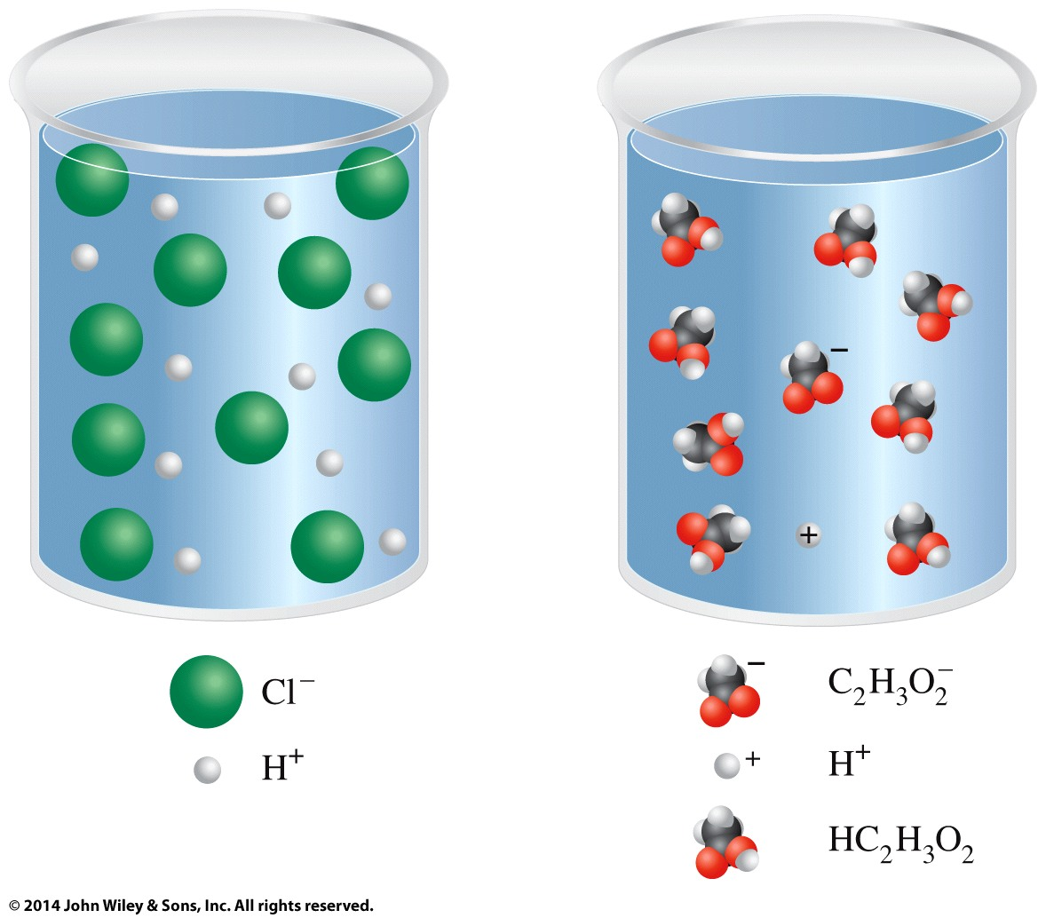
What is different about these solutions?

Slide 40
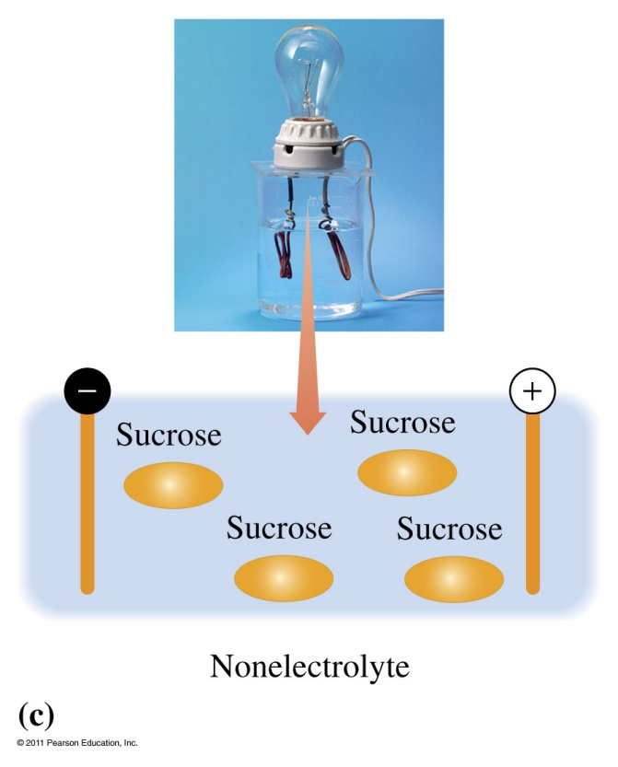
Are covalent compounds conductive?
A nonelectrolyte in an aqueous solution produces only molecules.

Slide 41
Example - Stoichiometry
How much of a 0.5223 M solution of NaOH is required to completely react with 3.457 g of oxalic acid (H₂C₂O₄)?

Slide 42
Example - Stoichiometry
If 58.7 mL of HCl solution were used to titrate 1.077 g of NaOH, what was the molarity of the HCl solution?

Slide 43
Example - Stoichiometry
A 25.00 mL sample of vinegar was titrated with 23.55 mL of a 0.2157 M sodium hydroxide solution. What is the concentration of acetic acid in the vinegar solution?

Slide 44
How does a bicarbonate buffer work?
Bicarbonate reacts with acid
HCO₃⁻ _{(aq)} + H⁺ _{(aq)} → H₂CO_{3 (aq)}
Bicarbonate reacts with base
HCO₃⁻ _{(aq)} + OH⁻ _{(aq)} → CO₃²⁻ _{(aq)}
Both acid and base can be neutralized by bicarbonate!

Slide 45
How does a solution of acetic acid and acetate ions function as a buffer?

Slide 46
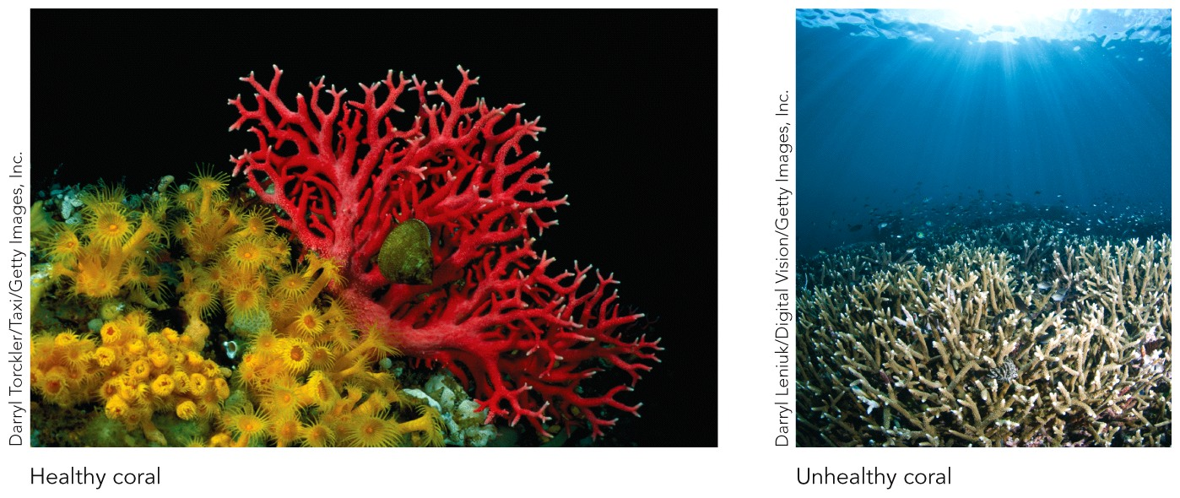
How does pH affect coral?

Slide 47
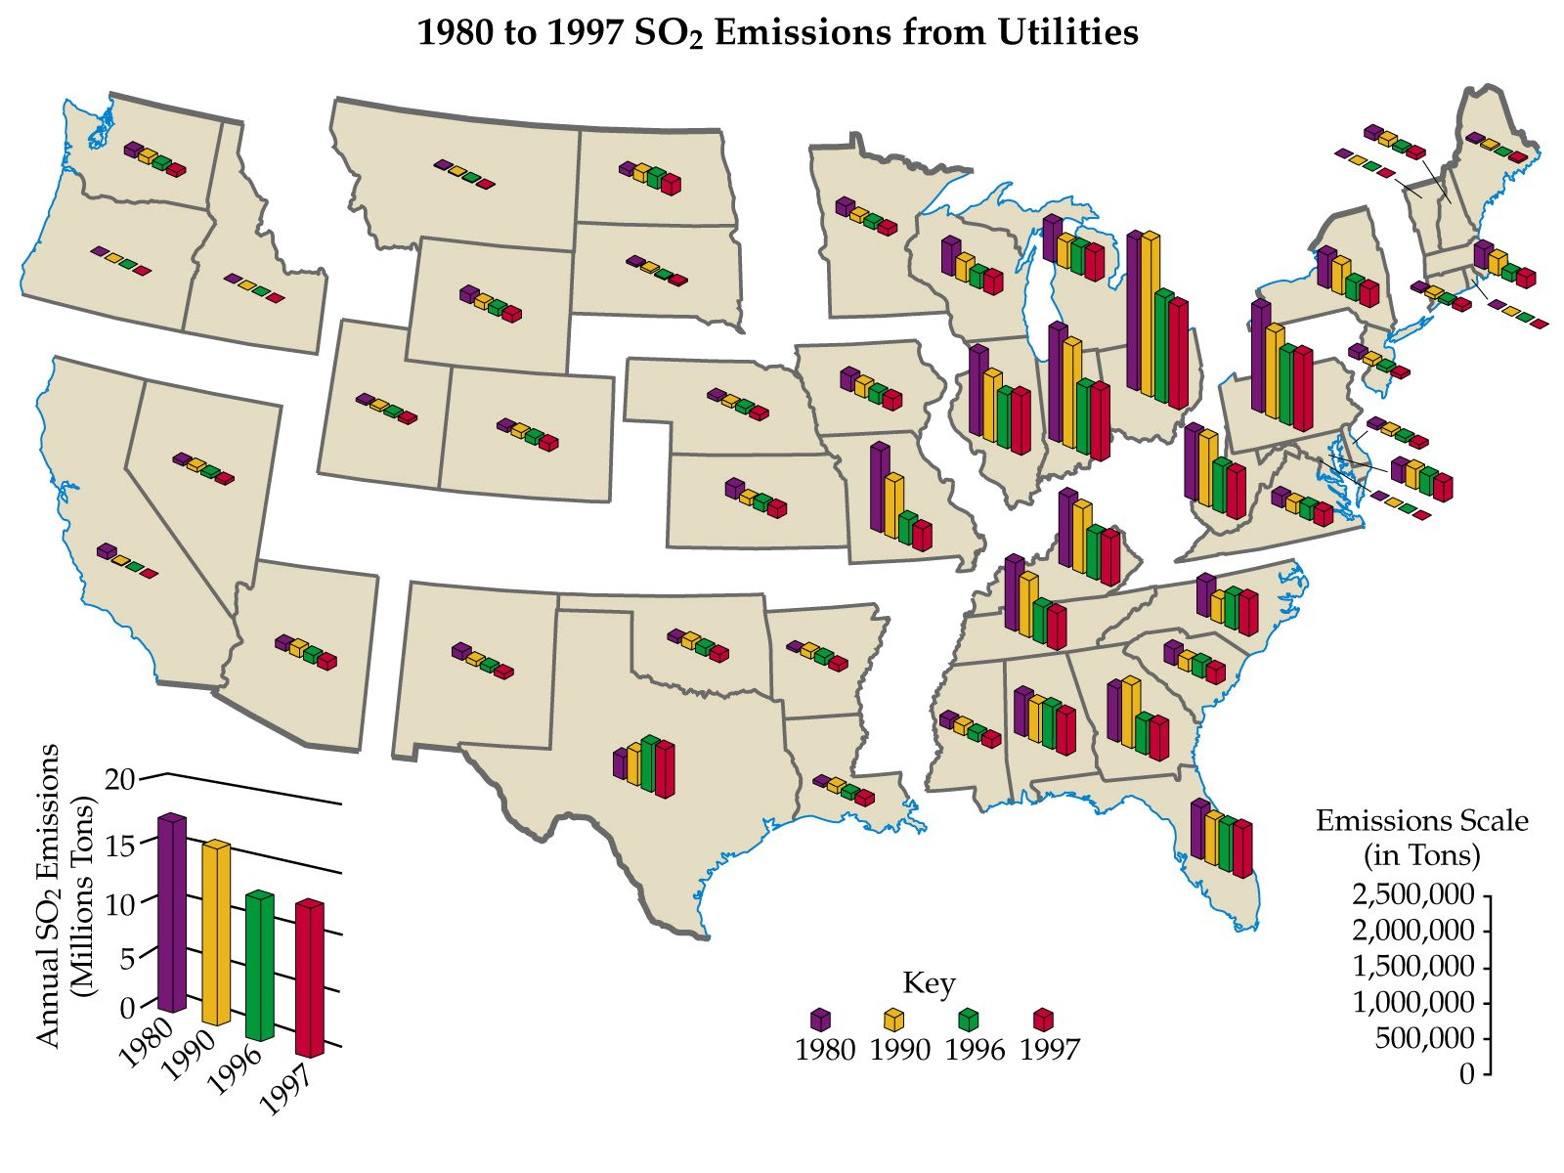

Slide 48
Example - pH
Calculate the pH of carrot juice with a hydronium ion, [H₃O⁺], concentration of 7.9 x 10⁻⁶ M.

Slide 49
Example - pH
Calculate the hydronium ion, [H₃O⁺], concentration of pea juice with a of pH of 6.409.

Slide 50
Example - pOH
What is the pOH of a solution that is 2.57 ×10⁻⁹ M in NaOH?

Slide 51
Example - pOH
What is the pOH of a solution that is 2.57 ×10⁻⁹ M in NaOH?
What is the pH?

Slide 52
Example – Conventional, Total Ionic and Net Ionic Equations
Zinc metal reacts with aqueous copper(II) chloride to produce copper solid and aqueous zinc chloride.
What is the net ionic equation?
Zn _{(s)} + CuCl_{2 (aq)} → Cu _{(s)} + ZnCl_{2 (aq)}
Zn _{(s)} + Cu²⁺ _{(aq)} + 2 Cl⁻ _{(aq)} → Cu _{(s)} + Zn²⁺ _{(aq)} + 2 Cl⁻ _{(aq)}
Zn _{(s)} + Cu²⁺ _{(aq)} → Cu _{(s)} + Zn²⁺ _{(aq)}
Zn _{(s)} + Cu²⁺ _{(aq)} + 2 Cl⁻ _{(aq)} → Cu _{(s)} + ZnCl₂ _{(aq)}
All spectator ions

Slide 53
Example – Conventional, Total Ionic and Net Ionic Equations
Aqueous ammonium nitrate reacts with aqueous sodium hydroxide to produce aqueous sodium nitrate and ammonia gas and water.
What is the total ionic equation?
NH₄NO_{3 (aq)} + NaOH _{(aq)} → NaNO_{3 (aq)} + NH_{3 (g)} + H₂O _{(l)}
NH₄ ⁺ _{(aq)} + NO₃⁻ _{(aq)} + Na⁺ _{(aq)} + OH- _{(aq)} → Na⁺ _{(aq)} + NO₃⁻ _{(aq)} + NH_{3 (g)} + H₂O _{(l)}
NH₄ ⁺ _{(aq)} + OH- _{(aq)} → NH_{3 (g)} + H₂O _{(l)}
All spectator ions
No reaction

